Slide 1
Diferenciación Numérica
Dr. Luis Sanchez

Slide 2
Motivation
How do you evaluate the derivative of a tabulated function.
How do we determine the velocity and acceleration from tabulated measurements.
Time (second) | Displacement (meters)
0 | 30.1
5 | 48.2
10 | 50.0
15 | 40.2

Slide 4
Taylor’s Expansion

Slide 5
Forward Difference Formula for
Geometrically
h

Slide 6
Backward Difference Formula for
Similarly
Geometrically
h

Slide 7
Central Difference Formula for
–)

Slide 8
Central Difference Formula for
Geometrically
2h

Slide 9
First Derivatives - Example:
Use forward ,backward and centered difference approximations to estimate the first derivative of
at x = 0.5 with h = 0.5 and 0.25 (exact sol. = -0.9125)
Forward Difference
Backward Difference

Slide 10
First Derivatives - Example:
Central Difference

Slide 11
Example
Remarks:
FD, BD, CD each involves 2 function calls, 1 subtraction, and 1 division: same computation time
CD is the most accurate (hence, the most recommended method)
However, sometimes, CD cannot be applied

Slide 12
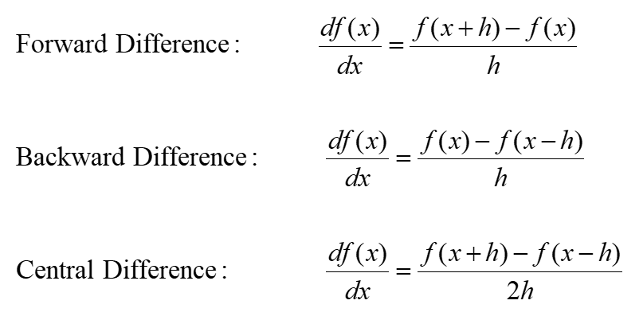
Three Formula Summary:

Slide 13
Forward Difference Formula for
–2×）

Slide 14
Backward Difference Formula for
–2×）

Slide 15
Central Difference Formula for
+)
Similar remark on the selection of FD|BD|CD applies for f”(x)

Slide 16
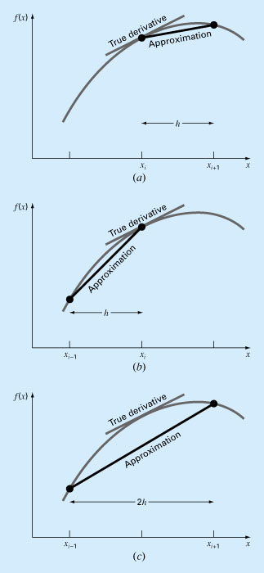
Numerical Differentiation
Forward difference
Taylor series :

Slide 17
Numerical Differentiation
2. Backward difference

Slide 18
Numerical Differentiation
3. Centered difference

Slide 19
High Accuracy Differentiation Formulas
High-accuracy finite-difference formulas can be generated by including additional terms from the Taylor series expansion.
An example: High-accuracy forward-difference formula for the first derivative.

Slide 20
More Accurate FD Formula for

Slide 21
More Accurate FD Formula (cont)
Better accuracy can be achieved using this formula
But, it involves more computations:
3 function calls, two +/–, one division
Trade-off:
More computation is the price you paid for better accuracy
Similar idea applies to more accurate BD formula.
Similar improved versions can be developed for the backward and centered formulas as well as for the approximations of the higher derivatives.

Slide 22
Higher Order Forward Divided Difference

Slide 23
Higher Order Backward Divided Difference

Slide 24
Higher Order Central Divided Difference

Slide 25
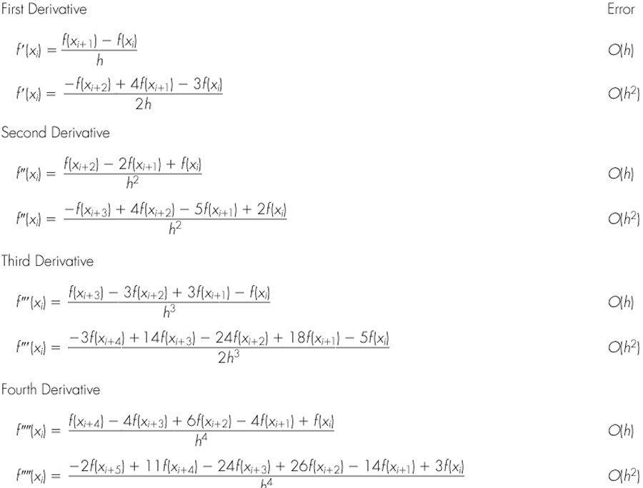
Forward Finite-divided differences

Slide 26
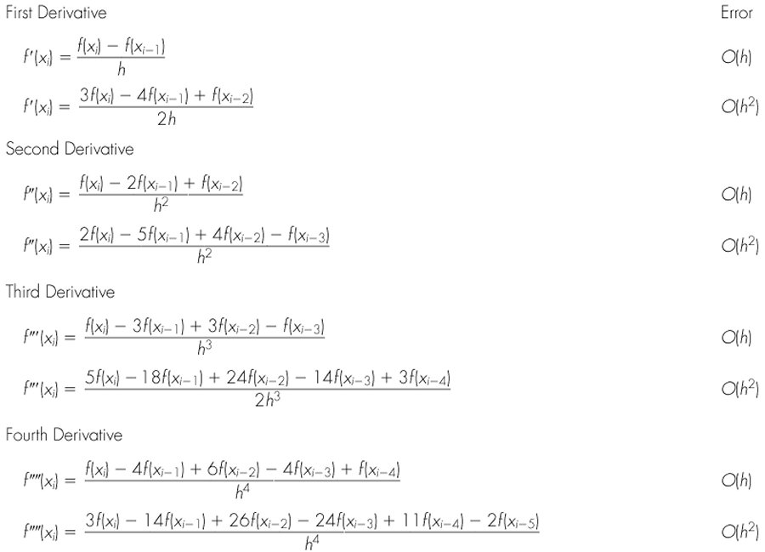
Backward finite-divided differences

Slide 27
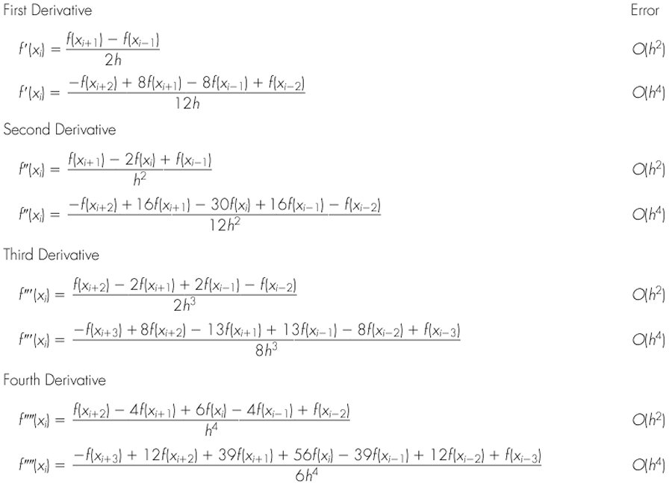
Centered Finite-Divided Differences

Slide 28
First Derivatives - Example:
Employing the high-accuracy formulas (h=0.25):
x_{i-2}= 0.0 f(0.0) = 1.2
x_{i-1}= 0.25 f(0.0) = 1.103516
x_{i} = 0.5 f(0.5) = 0.925
x_{i+1} = 0.75 f(0.75) = 0.63633
x_{i+2} = 1.0 f(1.0) = 0.2
Forward Difference

Slide 29
First Derivatives - Example:
Backward Difference
Central Difference

Slide 30
Summary
True value: f`(0.5) = -0.9125
Basic formulas
h = 0.25 | Forward O(h) | Backward O(h) | Centered O(h²)
Estimate | -1.155 | -0.714 | -0.934
|ε_{t}| | 26.5% | 21.7% | 2.4%
High-Accuracy formulas
h = 0.25 | Forward O(h²) | Backward O(h²) | Centered O(h⁴)
Estimate | -0.859375 | -0.878125 | -0.9125
|ε_{t}| | 5.82% | 3.77% | 0%

Slide 31
Richardson Extrapolation
Idea:
exact
= computed+ error
The truncation error is of the form: ch^{k}
where c is some constant
Use different h to estimate the truncation error
Use extrapolation to get more accurate result

Slide 32
Richardson Extrapolation (cont)
Example: CD for f’(x)
Using Different h (h₁, h₂)：
c₁ and c₂ could be different

Slide 33
Example
f(x) = x³. Use CD with Richardson extrapolation to compute f’(1)

Slide 34
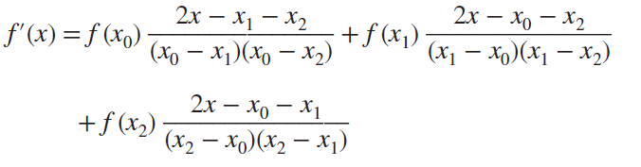
Derivatives of unequally spaced data
One way to handle nonequispaced data is to fit a Lagrange interpolating polynomial to a set of adjacent points that bracket the location value at which you want to evaluate the derivative. Remember that this polynomial does not require that the points be equispaced. The polynomial can then be differentiated analytically to yield a formula that can be used to estimate the derivative.

Slide 35
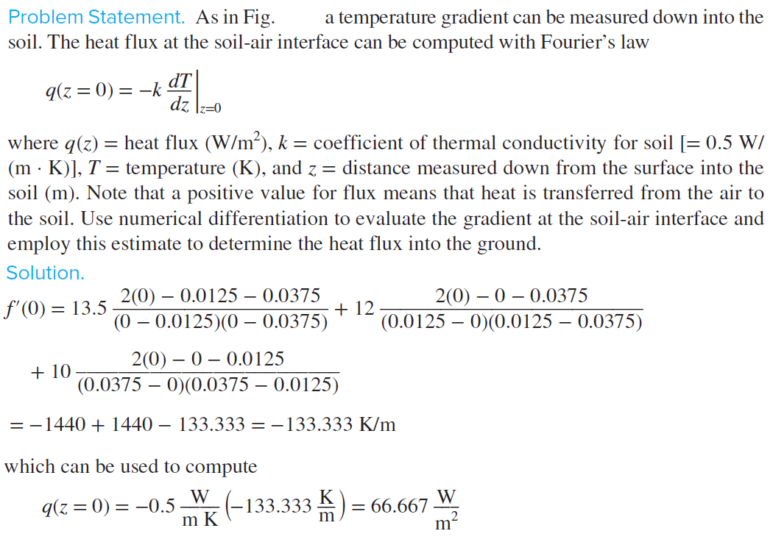
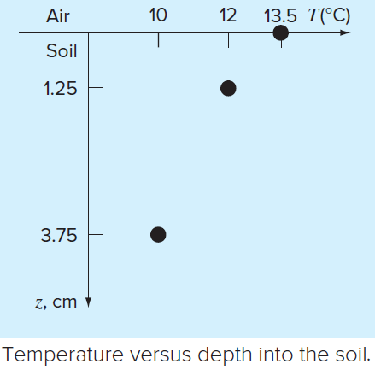

Slide 36
Matlab Built-in functions for numerical differentiation
MATLAB provides the diff function to use for computing derivative estimates.
Its syntax is d = diff(x), where x is a vector of values, and the result is a vector d containing the differences between adjacent elements in x.
That is, if x has n elements, d will have n - 1 elements, where
d = [x(2) - x(1), x(3) - x(2), . . . , x(n) - x(n -1)].

Slide 37
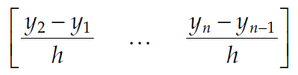
Equally spaced data. Consider a set of equally spaced data (x₁, y₁), …, (x_{n}, y_{n}), where x_{i+1} − x_{i} = h (i = 1, …, n − 1). Then, by the description of diff, the command diff(y)./h
returns the (n − 1)-dimensional vector
The first component is the first-derivative estimate at x1 using the forward-difference Formula. Similarly, the second component is the derivative estimate at x2. The last entry is the derivative estimate at x_{n−1}. As an example consider f(x) = e^{−x} sin(x/2), x = 1.2, 1.4, 1.6, 1.8. We find an estimate for f ′(1.4) as follows:
>> h = 0.2; x = 1.2:h:1.8;
>> y = [0.1701 0.1589 0.1448 0.1295]; % Values of f at the discrete x values
>> y_prime = diff(y)./h

Slide 38
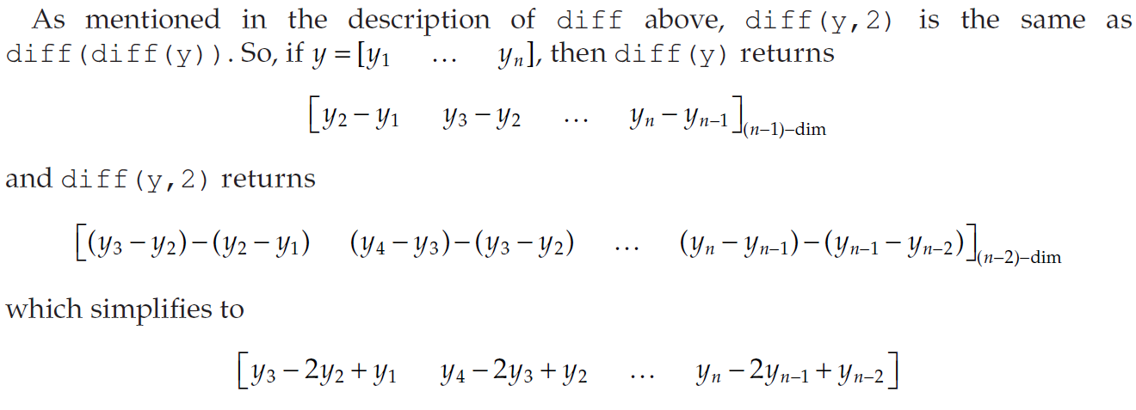

The first component is the numerator in the three-point forward difference formula for estimating the second derivative at x₁. Similarly, the remaining components agree with the numerator at x₂, …, x_{n−2}. Therefore, for an equally spaced data (x₁, y₁), …, (x_{n}, y_{n}), an estimate of the second derivative at x₁, x₂, …, x_{n−2} is provided by:

Slide 39
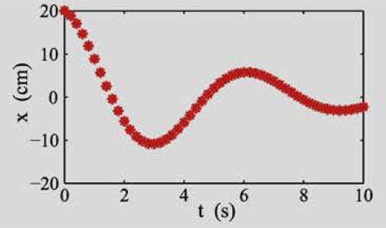
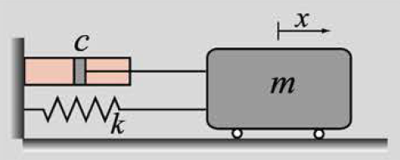
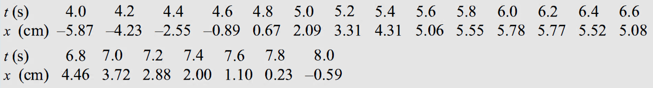
Exercise: Damped vibrations
In a vibration experiment, a block of mass m is attached to a spring of stiffness k, and a dashpot with damping coefficient c, as shown in the figure. To start the experiment the block is moved from the equilibrium position and then released from rest. The position of the block as a function of time is recorded at a frequency of 5 Hz (5 times a second). The recorded data for the first 10 s is shown in the figure. The data points for 4 ≤t ≤ 8 s are given in the table below.

Slide 40
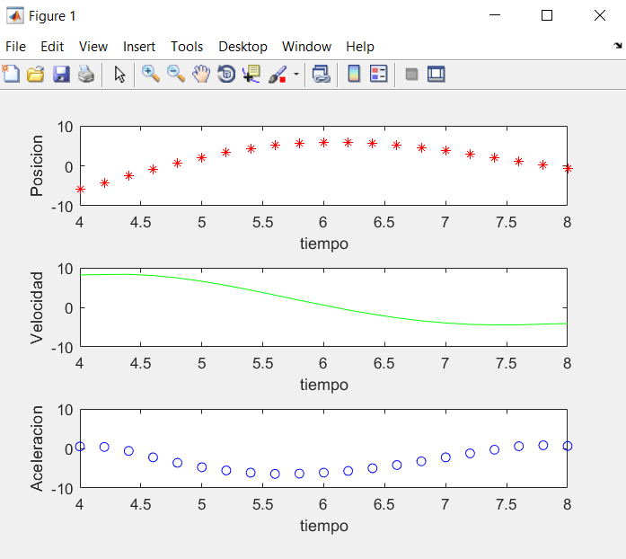
Exercise: Damped vibrations
(a) Write a user-defined MATLAB function that calculates the derivative of a function that is given by a set of discrete points. Name the function dx=derivative (x, y) where x and y are vectors with the coordinates of the points, and dx is a vector with the value of the derivative at each point. The function should calculate the derivative at the first and last points using the forward and backward finite difference formulas, respectively, and using the central finite difference formula for all of the other points. Use the given data points to calculate the velocity of the block for 4 ≤t≤ 8 s. Calculate the acceleration of the block by differentiating the velocity. Make a plot of the displacement, velocity, and acceleration, versus time for 4 ≤t≤ 8 s.

Slide 41
Polynomial differentiation functions.
Command
b = polyder(p)
b = polyder(p1,p2)
[num, den] = polyder(p2,p1)
Description
Returns a vector b containing the coefficients of the derivative of the polynomial represented by the vector p.
Returns a vector b containing the coefficients of the polynomial that is the derivative of the product of the polynomials represented by p1 and p2.
Returns the vectors num and den containing the coefficients of the numerator and denominator polynomials of the derivative of the quotient p₂/p₁, where p1 and p2 are polynomials.

